Slide 1
MEMORY POSSIBLE
[CLICK]
TECHNIQUES AND RESOURCES
[CONTINUE]

Slide 2
YOUR MISSION, SHOULD YOU CHOOSE TO ACCEPT IT, IS TO IMPROVE YOUR MEMORY SKILLS.
THIS GUIDE PROVIDES IMPERATIVE INFORMATION ABOUT THE BASICS OF MEMORY DEVELOPMENT AND ACTIONABLE THINGS YOU CAN DO RIGHT NOW.
PREPARE YOUR MIND FOR AN OVERHAUL.
GOOD LUCK.
THIS MESSAGE WILL SELF-DESCRUCT IN ...

Slide 3







Slide 4
CLICK CIRCLES TO
[EXPLORE]
WATCH
START
PLAY
READ
TRY

Slide 5
CLICK CIRCLES TO
[START]
PARTS OF THE BRAIN
MEMORY STATISTICS
PICTURES OF BRAIN SCANS
TYPES OF MEMORY
[RETURN TO EXPLORE]

Slide 6
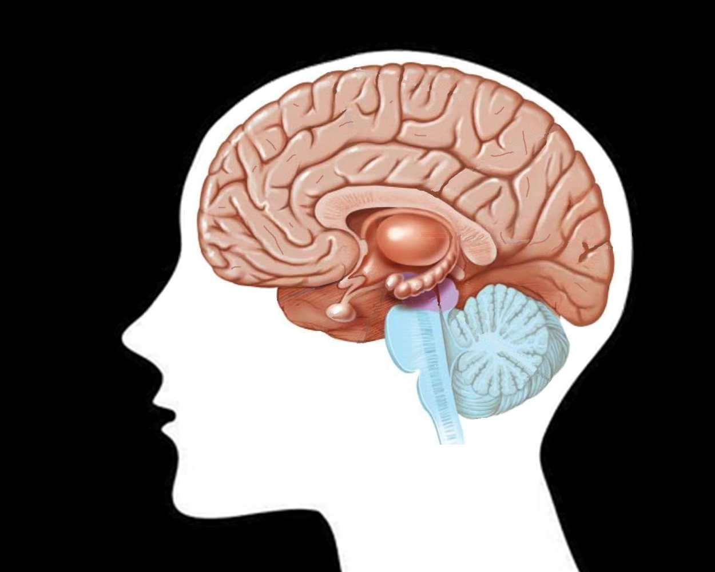
PREFRONTAL CORTEX
CEREBRAL CORTEX
HIPPOCAMPUS
AMYGDALA
[RETURN TO START]

Slide 7
PREFRONTAL CORTEX
THE PREFRONTAL CORTEX IS LOCATED AT THE FRONT OF THE BRAIN.
IT IS ASSOCIATED WITH SHORT TERM MEMORY (ALSO KNOWN AS WORKING MEMORY). ALZHEIMER’S AFFECTS SHORT TERM MEMORY RETENTION AND CONVERSION TO LONG TERM MEMORY.
[RETURN]

Slide 8
CEREBRAL CORTEX
THE CEREBRAL CORTEX IS THE OUTER LAYER OF THE BRAIN (GRAY MATTER).
IT COORDINATES THE RETRIEVAL OF INFORMATION FROM VARIOUS REGIONS OF THE BRAIN, SUPPORTING ALL FORMS OF MEMORY CREATION AND RETENTION.
[RETURN]

Slide 9
AMYGDALA
THE AMYGDALA IS ALMOND-SHAPED AND LOCATED NEAR THE HIPPOCAMPUS.
IT PROCESSES EMOTION AND HELPS IMPRINT MEMORIES. LIFE WITHOUT A FUNCTIONING AMYGDALA WOULD BE SENSELESS. MEMORY WOULD SUFFER, SINCE MOST PEOPLE STORE MEMORIES BASED ON SENSORY INFORMATION.
[RETURN]

Slide 10
HIPPOCAMPUS
THE HIPPOCAMPUS IS LOCATED DEEP IN THE BRAIN, CLOSE TO THE AMYGDALA.
IT PLAYS THE MOST IMPORTANT ROLE IN MEMORY CREATION BY CONVERTING SHORT-TERM MEMORY TO LONG-TERM MEMORY AND AIDS WITH SPATIAL NAVIGATION.
[RETURN]

Slide 11
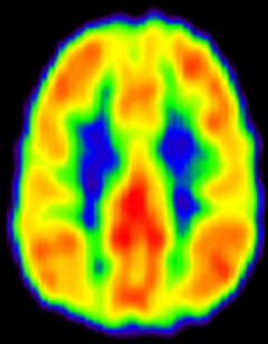
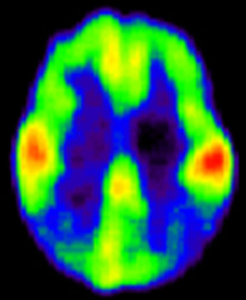
TYPICAL BRAIN
ALZHEIMER’S BRAIN
CLINICAL TRIAL QUESTIONS
[RETURN TO START]
Notes:
Alzheimer’s affects short term memory. The brain scans shown demonstrates how connectivity and activity can decline over as the disease progresses.
Questions asked in Alzheimer’s clinical patients:
Remember the following three-word sequence: truck, cabin, spoon.
What did you do for Thanksgiving last year?
Where did you go on your honeymoon?
Starting at 100, count backward by seven.

Slide 12
CLINICAL TRIAL QUESTIONS
REMEMBER A THREE-WORD SEQUENCE (EXAMPLE: PLANT, TURKEY, RED). TEST FOR RECALL AT THE CONCLUSION.
WHAT DID YOU DO FOR THANKSGIVING LAST YEAR?
STARTING AT 100, COUNT BACKWARD BY SEVEN.
[RETURN TO START]

Slide 13
TYPES OF MEMORY
LONG-TERM MEMORY (LTM)
SHORT-TERM MEMORY (STM)
[RETURN TO START]

Slide 14
SHORT TERM MEMORY (STM)
SHORT-TERM MEMORY HAS THREE OPTIONS:
* DISREGARD INFO (SENSORY STIMULI IS FORGOTTEN ALMOST INSTANTLY).
* RETAIN IT BY REHEARSAL.
* TRANSFER IT TO LONG TERM MEMORY (LTM).
TYPICAL ADULTS CAN HOLD 5-9 ITEMS AT A TME FOR 10-20 SECONDS.
[RETURN]

Slide 15
LONG TERM MEMORY (LTM)
LONG-TERM MEMORY HAS A LONG DURATION FOR RETENTION, UNLIMITED STORAGE CAPACITY, AND A RICH NETWORK OF INTERCONNECTIONS.
WHATEVER YOU REMEMBER 12-24 WEEKS AFTER LEARNING, YOU MOST LIKELY WILL ALWAYS REMEMBER IT.
[RETURN]

Slide 16
MEMORY STATISTICS
LEARNERS RETAIN:
* 10% OF WHAT THEY READ.
* 20% OF WHAT THEY HEAR.
* 30% OF WHAT THEY SEE.
* 50% OF WHAT THEY SEE AND HEAR.
* 70% OF WHAT THEY SAY.
* 90% OF WHAT THEY SAY AND DO.
[RETURN TO START]
Notes:
University of Texas, Metcalf study conducted in 1997

Slide 17
CLICK CIRCLES TO
[READ]
BOOKS
SQ3R READING METHOD
SUPPLEMENT ARTICLE
MINDTOOLS WEBSITE
AGING BRAIN ARTICLE
[RETURN TO EXPLORE]

Slide 18

WORD TEMPLATE
ARTICLE AND VIDEO
[RETURN TO READ]
Notes:
SQ3R:
Survey
Scan the document for organization, structure, formatting, content, and other details before conducting a more thorough read through. This step ensures that the information provides the level of detail to suit your needs.
Question
List questions you have after the survey.
Read
Read through the document and take notes about the material covered. Ensure that you find answers to the questions you had in the previous section. Consider using the mind mapping and Cornell note-taking methods. Create a quiz based on the most important parts of the document to test yourself later.
Recall
Run through the information a few times, and make sure that you understand it enough to explain it to someone else. If you can’t, go through it again. Identify ways to associate information you already know to the information you are trying to remember.
Review
Convert this information into long term memory (LTM) by reviewing it frequently. Schedule times to review the notes and highlights to remind yourself about the important aspects of the document. Practice your new-found information as often as possible. Look for opportunities to discuss it with other people. Create a fact sheet for quick reference.

Slide 19




RECOMMENDED READING
[RETURN TO READ]

Slide 20
CLICK CIRCLES TO
[WATCH]
MEMORY CHAMPION – PART 1
MEMORY CHAMPION – PART 2
METHOD OF LOCI
[RETURN TO EXPLORE]

Slide 21
CLICK CIRCLES TO
[PLAY]
VARIOUS
FREE ONLINE GAMES
SUDOKU
CROSSWORDS
SCRABBLE
LUMOSITY
[RETURN TO EXPLORE]

Slide 22
CLICK TO
[TRY]
MENTAL CONTRIBUTIONS
PHYSICAL CONTRIBUTIONS
SOCIAL CONTRIBUTIONS
[RETURN TO EXPLORE]

Slide 23
SLEEP
TDCS
WATER CONSUMPTION
[PHYSICAL CONTIBUTIONS]
NUTRIENTS
MEDITATION
EXERCISE
[RETURN TO TRY]

Slide 24
JOURNAL WRITING
MNEMONICS
[MENTAL CONTIBUTIONS]
VISUALIZATION
[RETURN TO TRY]

Slide 25
NEW CONVERSATIONS
NEW PEOPLE
[SOCIAL CONTIBUTIONS]
NEW ACTIVITIES
NEW HOBBIES
[RETURN TO TRY]

